Slide 1


Latency Leaders
ARQ
Automatic Repeat Request
Members-
Aniket
Satyam
Gurshaan
Chaya
Mukesh
Team Presentation

Slide 2
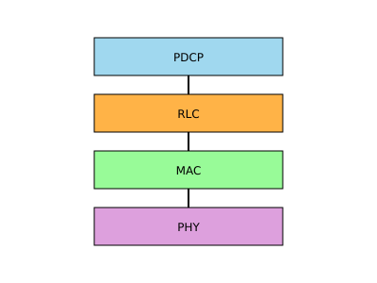
Latency Leaders
WHAT IS ARQ?
ARQ (Automatic Repeat Request) is a technique used to ensure the reliable delivery of data by retransmitting lost or corrupted packets.
In RLC ARQ, the sender waits for an acknowledgment (ACK) from the receiver for each transmitted data packet. If the acknowledgment is not received or a negative acknowledgment (NACK) is sent (indicating a loss or corruption), the packet is retransmitted.

Slide 3
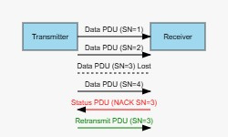
Latency Leaders
REAL-LIFE EXAMPLE

Slide 4
Latency Leaders
Real-World Example: ARQ in RLC
📱 Imagine you are texting a friend, but due to a weak network, some words are missing.
You send: "Meet me at the coffee shop at 5 PM."
Your friend receives: "Meet me at the … shop at 5 PM."
Your friend replies: "I didn’t get the missing word. Send again!"
You resend: "coffee"
Your friend gets the full message.
Here, the missing part of the message (coffee) is resent instead of the entire message—just like Selective Repeat ARQ in RLC.

Slide 5

Latency Leaders
WORKING OF RLC ARQ PROCEDURE

Slide 6
The ARQ procedure consists of the following key steps:
Transmission of Data: The sender (typically the mobile device or base station) transmits data packets (called RLC blocks or RLC SDUs) to the receiver (base station or mobile device).
Acknowledgment: The receiver sends an acknowledgment (ACK) back to the sender after successfully receiving a packet. If the packet is not received correctly or if there is a loss, a negative acknowledgment (NACK) is sent.
Retransmission of Lost Packets: If the sender does not receive an acknowledgment (or receives a NACK) for a specific packet, it will retransmit that packet. This retransmission can continue until the packet is successfully acknowledged, or a maximum number of retransmissions is reached.

Slide 7
Sequence Numbering: Each transmitted data packet is assigned a unique sequence number, allowing the receiver to determine the order of packets and detect lost packets.
Buffering: The sender and receiver maintain buffers to temporarily store data. The receiver keeps track of successfully received packets and their order. The sender may also buffer packets that have been transmitted but not yet acknowledged, allowing for retransmissions when necessary.

Slide 8
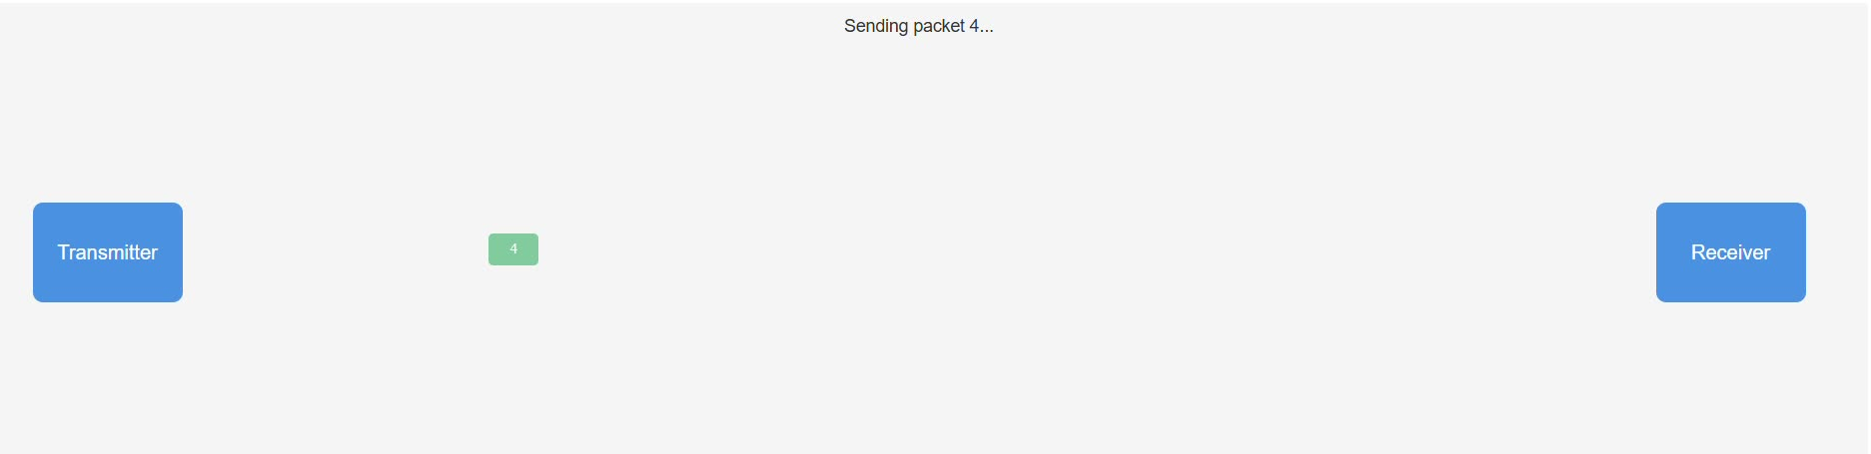
Latency Leaders
WORKING OF ARQ

Slide 9

Latency Leaders
TYPES OF ARQ

Slide 10
There are three main types of Automatic Repeat Request (ARQ) mechanisms used in data communication to ensure reliable transmission:
Stop-and-Wait ARQ
Go-Back-N ARQ
Selective Repeat ARQ

Slide 11
STOP-AND-WAIT ARQ
How it Works:
The sender transmits one data packet and waits for an acknowledgment (ACK) before sending the next packet.
If an ACK is received, the sender transmits the next packet.
If a Negative Acknowledgment (NACK) or no response is received (timeout occurs), the sender retransmits the same packet.
Pros:
Simple and easy to implement.
Requires minimal memory as only one packet is in transmission at a time.
Cons:
Inefficient for high-latency networks because the sender has to wait before sending the next packet.
Throughput is limited since only one packet is sent at a time.
Use Cases:
Low-speed and low-latency networks where simplicity is preferred over efficiency.

Slide 12
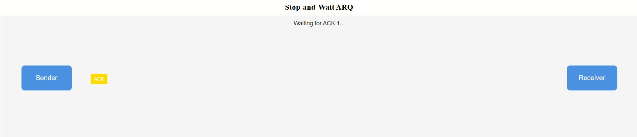
Latency Leaders
SAMPLE IMPLEMENTATION OF STOP-N-WAIT ARQ

Slide 13
GO-BACK-N ARQ
How it Works:
The sender can send multiple packets (up to a predefined window size) without waiting for an acknowledgment.
If an error is detected (NACK received or timeout occurs), the sender retransmits the erroneous packet and all subsequent packets in sequence.
Uses a sliding window mechanism to manage the flow of packets.
Pros:
More efficient than Stop-and-Wait ARQ because multiple packets are in transit at the same time.
Better throughput in high-latency networks.
Cons:
If a single packet is lost, all subsequent packets need to be retransmitted, even if they were received correctly.
More buffer space required compared to Stop-and-Wait ARQ.
Use Cases:
Used in wireless communication (e.g., RLC layer in LTE networks).
Good for networks where retransmissions are necessary but not too costly.

Slide 14
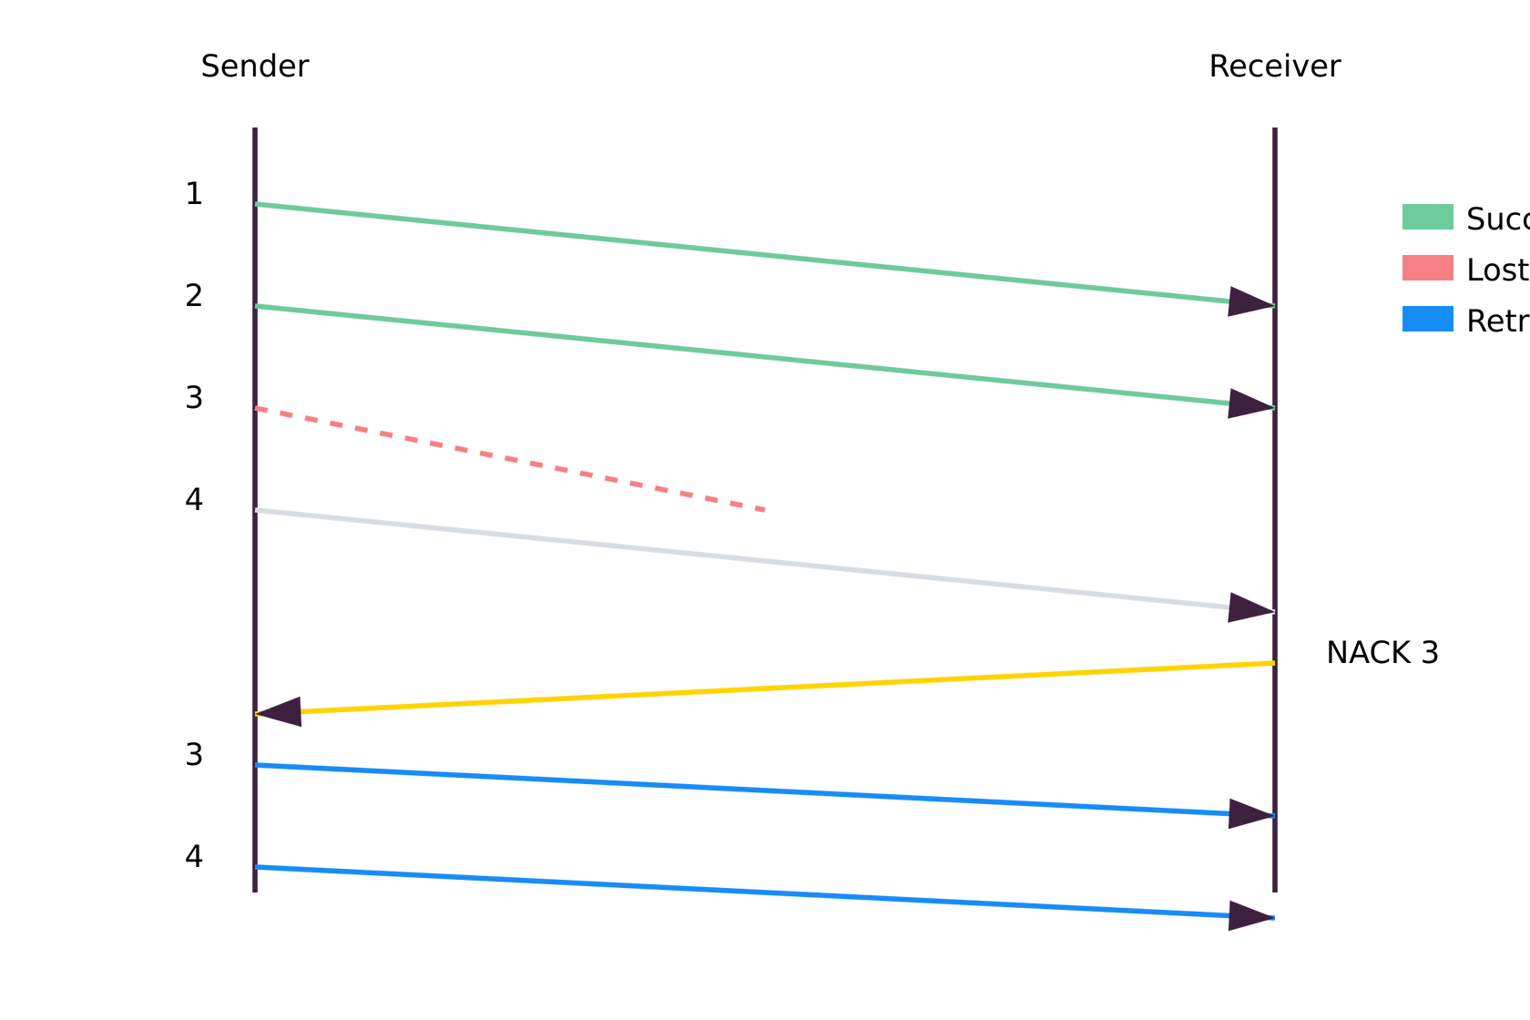
Latency Leaders
SAMPLE IMPLEMENTATION OF GO-BACK-N-WAIT ARQ

Slide 15
SELECTIVE REPEAT ARQ
How it Works:
The sender transmits multiple packets without waiting for an acknowledgment.
If a packet is lost or corrupted, the receiver requests only that specific packet to be retransmitted (instead of retransmitting all subsequent packets like in Go-Back-N).
The receiver stores correctly received packets in a buffer and waits for the missing packet to arrive.
Pros:
More efficient than Go-Back-N because only the lost/corrupted packets are retransmitted.
Higher throughput as unnecessary retransmissions are avoided.
Cons:
Requires more complex processing and larger buffer memory at both sender and receiver to handle out-of-order packets.
Higher overhead due to the need for individual acknowledgments.
Use Cases:
Used in high-speed and high-latency networks where efficiency is critical (e.g., LTE/5G RLC layer, TCP).
Satellite and wireless communications where retransmission costs are high.

Slide 16
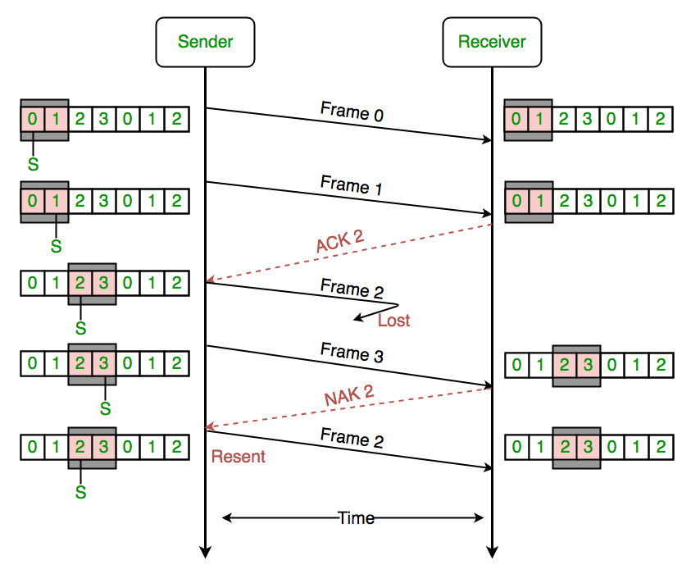
Latency Leaders
SAMPLE IMPLEMENTATION OF SELECTIVE REPEAT ARQ

Slide 17
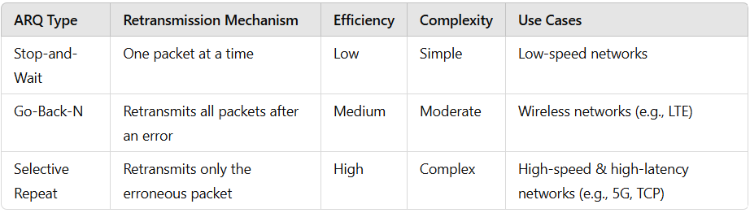
Latency Leaders
COMPARISON BETWEEN ARQ TYPES

Slide 18
Latency Leaders
KEY PARAMETERS IN RLC ARQ

Slide 19
Max Retransmissions: The maximum number of retransmissions allowed for a packet. If the packet is not successfully received within these attempts, the data may be discarded or an error is triggered.
Window Size: RLC ARQ uses a sliding window mechanism for flow control. It allows the sender to transmit multiple packets without waiting for individual acknowledgments but ensures that the sender doesn't overwhelm the receiver.
Sequence Number: The sequence number is used to identify each data packet uniquely. It ensures that the receiver can detect packet losses and handle out-of-order packets.

Slide 20

Latency Leaders
ERROR HANDLING

Slide 21
If a packet is lost or corrupted during transmission, the receiver cannot decode it correctly. In such cases:
Negative Acknowledgment (NACK) is sent to inform the sender that retransmission is required.
The sender will then use the ARQ mechanism to retransmit the lost or corrupted packet.

Slide 22
Latency Leaders
RLC ARQ IN ACTION
Step 1: The sender transmits data packets.
Step 2: The receiver acknowledges the receipt of the packets (ACK).
Step 3: If the receiver detects an error (lost or corrupted packet), it sends a NACK.
Step 4: The sender retransmits the lost packet.
Step 5: The receiver acknowledges the successful receipt of the retransmitted packet.

Slide 23

Latency Leaders
BENEFITS OF RLC ARQ

Slide 24
Reliability: Ensures that data is transmitted correctly over the wireless link.
Error Detection and Recovery: Can recover from errors such as lost or corrupted packets.
Efficiency: The sliding window and ARQ mechanisms help optimize the use of bandwidth and reduce retransmissions, making communication more efficient.

Slide 25

Latency Leaders
CHALLENGES

Slide 26
Delay: Continuous retransmissions can introduce delay, especially in cases of poor signal quality.
Buffering: Managing buffer space for retransmissions requires additional resources.
Overhead: The ARQ process adds some overhead due to the need for acknowledgment packets.

Slide 27
Latency Leaders
CONCLUSION
In summary, the RLC ARQ procedure is essential for maintaining data integrity and reliability in wireless communication systems by using a mechanism for retransmitting lost or corrupted packets and ensuring efficient data transfer.

Slide 28
Latency Leaders
THANK YOU!
FOR YOUR ATTENTION

